Slide 1
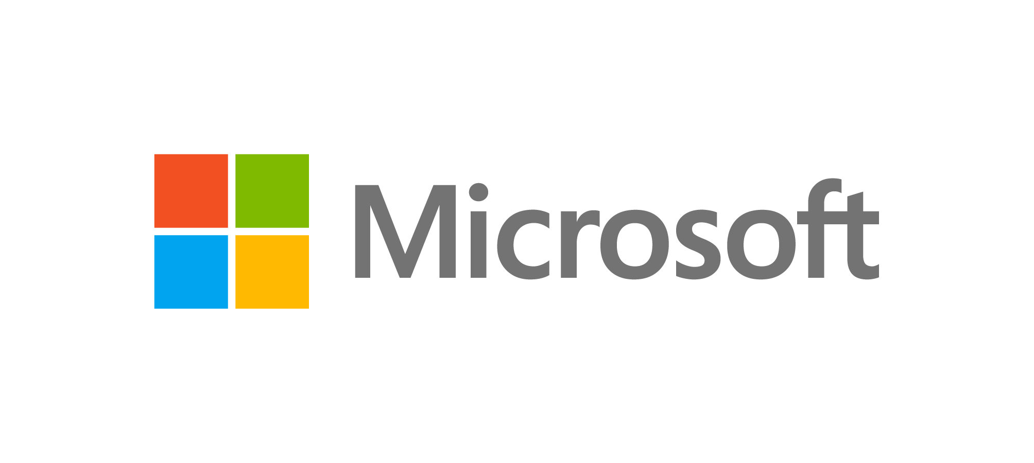
Companies choose Azure for Windows Server and SQL Server because of its unmatched security
Enterprises already choose Windows Server and SQL Server for their proven security and compliance capabilities.
Today, they’re discovering that they not only run best on Azure, but that Azure delivers multiple layers of security, including the secure foundation of our physical datacenters, operational best practices, and engineering processes that follow industry-standard guidelines.
Unmatched security
$1 billion
security investment
every year
6.5 triIIion
threat signals
analyzed daily
3,500
dedicated
security experts
90+ compliance
offerings
Uncompromising commitment to privacy
We're seeing a huge benefit in terms of scalability. We build out resources in the cloud as we need them, in a way that would have been impossible in a physical datacenter. We also trust in the security of Azure, which is important for any business site.
Sarah Haywood, CTO and VP of Technology, Carlsberg Group

