Slide 1

Microsoft Teams Platform
The hub for teamwork in Microsoft 365

Slide 2

In April 2020, the
remote workforce grew
to nearly half of all
workers – 98% of them
expressed wanting to have
the option to work from
home for the rest
of their careers
Notes:
In April 2020, an MIT survey of over 25,000 workers found that 34% had shifted to working from home and another 15% was already doing so – which, according to researchers, means that nearly half of all US workers are now remote
Source: https://www.forbes.com/sites/nextavenue/2020/04/10/is-working-from-home-the-future-of-work/#665a15b146b1
98% source: https://www.forbes.com/sites/enriquedans/2020/06/06/working-from-home-its-now-athing/#7e1494775d54
122% of the S&P is outperformed by companies with a great employee experience
Source:https://www.accenture.com/t20170628T011731Z__w__/us-en/_acnmedia/PDF-54/Accenture-Employee-Experience-Transcript.pdf

Slide 3
Microsoft Teams Platform
Microsoft Teams Platform is an integrated workplace solution, fueling organic interactions, fostering a culture of collaboration, and enhancing your organization's productivity.
On the Microsoft Teams platform, you can stretch far beyond chat, meeting, and calling. Leverage readymade apps, take advantage of low code tools, and develop custom solutions, making Teams the central tool for productivity from the start of the day to the finish.
It's not just a meeting space, but "the work app" and hub for everything your team does.
Apps and workflow
Chat and Collaboration
Meetings and Calling
Notes:
Chats & Collaboration
Meetings and Calling,
Apps & Workflows
So, what is Microsoft Teams?
Microsoft Teams is a hub for teamwork, which brings together everything a team needs: chat and threaded conversations, meetings & video conferencing, PSTN calling, content collaboration with the power of Office 365 applications, and the ability to create and integrate apps and workflows that your business relies on.
[click to build slide]
And because Microsoft Teams is a part of Office 365, it comes with the enterprise grade security, compliance, and manageability that our customers expect and value.

Slide 4


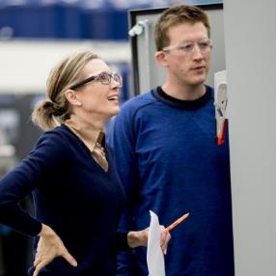
Connecting digital workplace communities
Enhanced virtual communication
Ready made apps
and low code tools
Enterprise
grade security
Connect in real time with threaded, persistent, and contextual chat
Integrate your favorite tools
across Office 365
Communicate across geographies with anyone through phone systems and calling plans
Drive meaningful collaboration with intelligent meetings
Build customized workflows, applications, and bots
Discover a library of partner apps for off-the-shelf access to useful features and integrations
Explore custom applications and boost productivity by automating routine tasks
Utilize built-in information protection with a global hyper scale cloud
Create secure access with Multi-Factor Authentication and protect your data
Ensure compliance and governance across the board

Slide 5

Enhanced virtual communication
Connect in real time with threaded, persistent, and contextual chat
  Host 1:1 meetings, group conversations, or virtual events and chat in a humanized digital workspace
Integrate your favorite tools across Office 365
  All your common tools, all the Office apps that people use every day - Word, Excel, PowerPoint, OneNote, SharePoint, even Power BI - are all built-in, giving people access to the files and tools they need right within Microsoft Teams
Communicate across geographies with anyone through phone system and calling plans
  Access a dedicated phone number for domestic and international calls with advanced features including voicemail, transfer, and emergency calling
Drive meaningful collaboration with intelligent meetings
  Find related files or chat histories at your fingertips with cloud recording with transcription and translation, indexed for searching

Slide 6
Readymade apps and low code tools
Build customized workflows, applications, and bots
  Integrate your own apps and services to improve productivity, make decisions faster, provide focus (by reducing context switching), and create collaboration around existing content and workflows
Discover a library of partner apps for off-the-shelf access to useful features/integrations
  Access the right set of tools to keep your team informed, aligned,
  and engaged – with over 450 apps to enable flexibility
Explore custom applications and boost productivity by automating routine tasks
  Reduce costs by outsourcing repetitive tasks to bots that work on your team's behalf and automate workflows to align with your needs

Slide 7
Enterprise-grade security
Utilize built-in information protection with a global hyper scale cloud
  Safeguard your information with a global hyper-scale cloud (including the ability for local data residency) and manage all aspects in a single coherent admin experience
Create secure access with multi-factor authentication and protect your data
  Protect against malware in attachments, accidental sharing via chat/files, or suspicious activity with advanced protections/device management
Ensure compliance and governance across the board
  Ensure support for more than 90 regulations and standards with advanced administrator control - compliance leadership with EUMC, HIPAA, and more
Notes:
R

Slide 8


Foundations of Microsoft Teams
Exchange
SharePoint Online
Azure Active Directory
Groups in Office 365
OneNote
Proven Media Stack
Microsoft Teams is built on existing Microsoft technologies

Slide 9

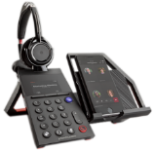
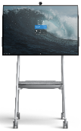

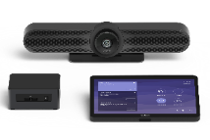


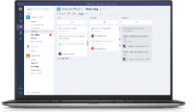

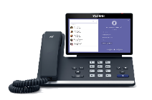

Microsoft Teams Devices
Personal Devices
Shared Devices
Mobile
devices
Personal
computers
Desk phones and
peripherals
All-in-one collaboration devices
Teams
Rooms
Large screen
interactive displays
A range of certified devices in every size, for every space and working style
Consistent Teams experience with more seamless transitions across devices
Integration of software and hardware to enhance the meeting experience
Companion experiences with mobile devices for meetings
Built-in skills and intelligence to support the meeting and calling lifecycle
Notes:
Let’s just focus for a minute on the Microsoft Teams, and the power of having Teams on all your devices.
Teams is already on the PC and mobile devices. The Teams app on mobile devices and laptops creates a familiar UI that’s consistent across devices, enabling full sharing and presenting features for everyone, straight from the app.
Personal peripheral devices, like headsets or speakers, have been engineered to integrate easily with the Teams app, helping you get meetings started faster by joining with a single click.
Teams is coming to desk phones, conference phones, Room Systems and of course Surface Hub 2S.
By bringing Teams to all these devices, users will have a consistent experience. No matter what space or device they are using, how they join meeting, share content, add people to the meeting, etc, it will be the same. No more trying to figure out to get a conference call started in a room because the tech in that room is different from the last room you were in.
Microsoft is working with its OEM partners to ensure that the hardware and software are integrated to work well together and to deliver on that universal experience.

Slide 10

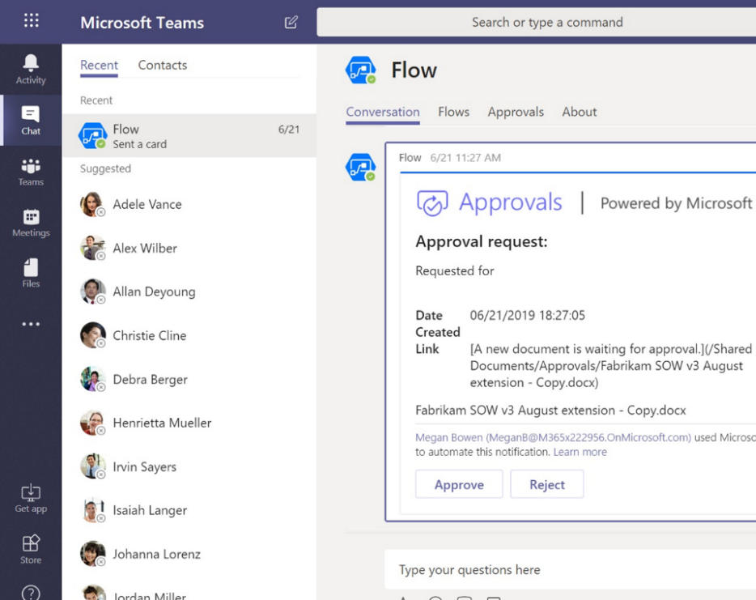
Integrated workflows and business apps
Create integrated solutions that automate routine tasks and streamline processes
  Integrate and automate apps and workflows within Microsoft Teams
  Connect to 300+ services and automate alerts and workflows with Microsoft Flow
  Develop no-code and low-code apps and forms with PowerApps
  Uncover and visualize insights with Power BI
  Collect, manage, and distribute content and data using SharePoint, Microsoft Forms,
  and Excel
Notes:
Streamline business processes with customized apps and workflow automation
Create [integrated] business solutions that streamline business processes [and automate workflows]

Slide 11
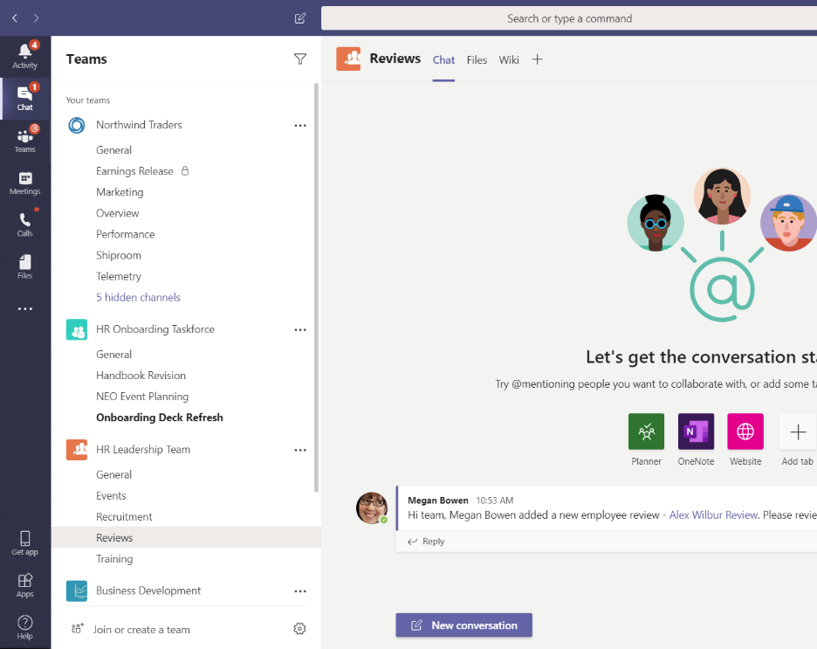
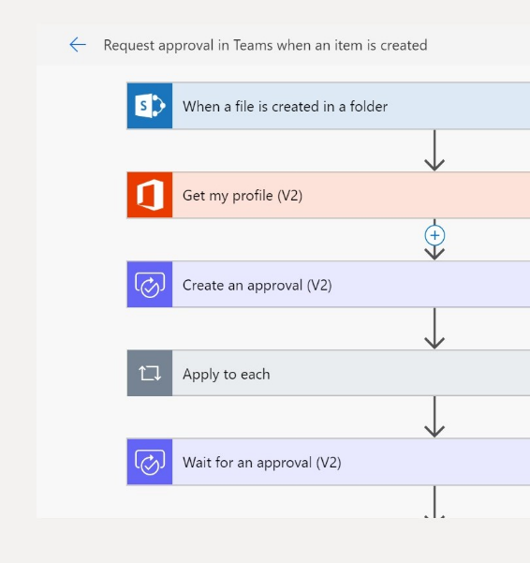
Automate routine tasks with Microsoft Flow
  Automate existing business processes with no-code and low-code solutions​
  Connect and automate 300+ cloud and
  on-premises data services
  Use prebuilt templates for business processes like approvals, alerts, data collection and reminders
  Use advanced scenarios with branching conditions, multiple steps, Visio process modeling, and more

Slide 12
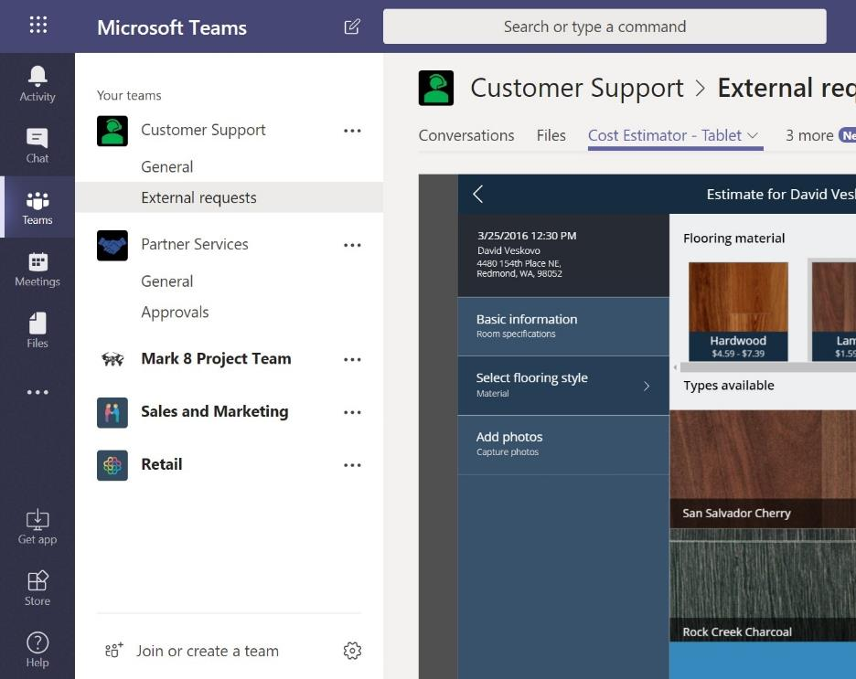
Build custom apps with PowerApps
  Build no-code and low-code apps for PC and mobile within Microsoft Teams
  Access PowerApps within a Teams channel
  Add productivity apps from the app store, including ISV, LoB, and citizen developer apps
  Easily build and deploy custom forms to Teams
  Connect to business data in lists, CDS, or any of 300+ connected services

Slide 13
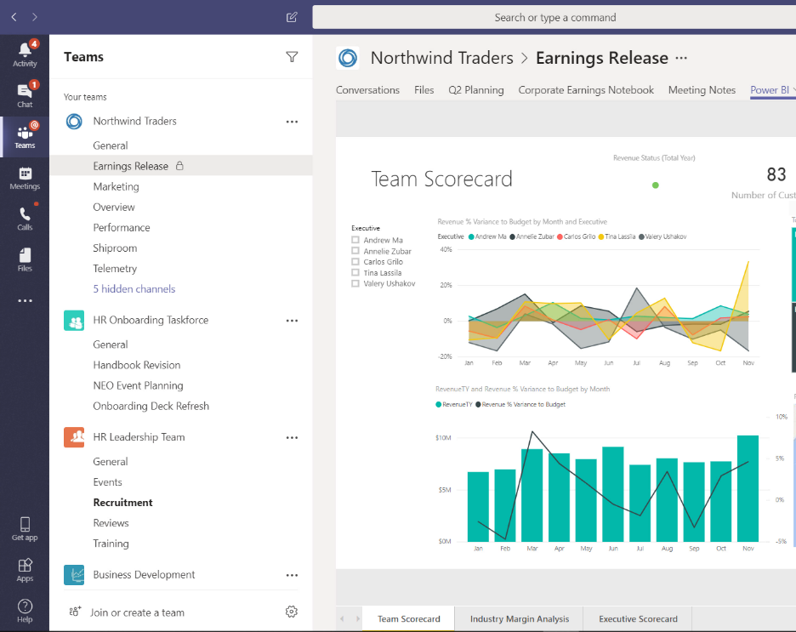
Uncover insights with Power BI
  Make sense of data with beautiful and insightful visualizations
  Add Power BI reports as a tab in teams' channel or to custom dashboards
  Share data insights during meetings, in Teams
  Easily create reports from Excel or CSV
  files in SharePoint libraries

Slide 14





Customer momentum
500k
organizations
use Teams
91
Fortune 100 companies use Teams
53
languages are supported in Teams
350
customers have 10k or more active Teams users
20M
daily active Teams users
Notes:
More than 500,000 organizations are using Teams today, including 91 of the Fortune 100 companies.
These organizations are using Teams deeply – more than 150 companies have more than 10,000 users of Teams and those numbers increase every week.

Slide 15






“What’s transformative is the way we’re connecting people, making data accessible to a broader employee base and giving them the skills to analyze the data to make better informed decisions. That can have obvious benefits, like increasing efficiency, but also an impact on topics that are central to our business, such as sustainability.”
Jane Moran, CIO | Unilever
Business outcomes
Top integrations leveraged
Increased business agility
New apps and BI tools give insights into how to improve the supply chain and conservation efforts
Centralized information
Connected their engineers around the world with Teams, allowing for global collaboration
PowerApps
Notes:
Link to story: "Now it’s personal: Unilever’s digital journey leads to real results for consumers and employees"
Partner leveraged: Microsoft Teams SLATE engineering program
Capabilities/solutions leveraged: Azure DevOps and PowerApps
Story summary:
Challenge: One of Unilever’s major goals is to become completely data-insights driven. No small feat for a global giant operating in 190 countries - and one that requires digitally rewiring their supply chain and generating real-time, democratized information. As part of this new system, they also needed a better way to connect employees and to give them the tools they needed to solve many issues on their own.
Solution: To connect employees, they relied on Teams as their primary communication and collaboration tool - and it's been a real game changer. For example, 2,000 engineers, most of whom had never really have spoken, started sharing ideas and making a big impact on productivity and efficiency.
Unilever then turned to Microsoft PowerApps to give employees the real-time data, intelligence and analytics they needed to create their own solutions - no developer necessary. With such valuable information, conversation and collaboration started happening in real-time and has led to great success. In fact, one Unilever employee recently saw a demo for PowerApps and created a quality assurance PowerApp herself. Her app is now available in all of Unilever’s factories and is a vast upgrade from the manual process that was previously used for quality checks.
Outcome: Supported by powerful Microsoft technology, Unilever has shifted from a project-based approach to a platform strategy - allowing them to be much more agile and much more scalable – and making their employees an even more vital part of this important transformation and standardizing their collaboration platform to centralize information.

Slide 16




“Onboarding new employees was an extremely slow, tedious task. Sometimes, it would take us up to a few weeks to get someone through the systems. We needed a better way… We invested in Teams and the Power Platform, and today we now centralize onboarding—so it begins and ends in Teams—and we have reduced the time from weeks to just 40 minutes.”
Thomas Pagnoux, Head of End User Services | Havi
Business outcomes
Top integrations leveraged
Automation
Streamlined their entire employee onboarding process, automating the it in a Teams-based app
Time savings
Cut out many manual touch-points and ensures new team members can hit the ground running
Notes:
Link to story: "How to revive your IT investments with Teams"
Link to video: Havi Teams platform video
Partner leveraged: N/A, internal development
Capabilities/solutions leveraged: PowerApps & Microsoft Flow, Connectors
Story summary:
Challenge: HAVI is a global logistics organization working with some of the world’s largest brands. With nearly 10,000 employees across the globe, many of whom are freelancers with very short-term contracts, HAVI (and their marketing group, The Marketing Store) needed a better way to manage these contracts and move from relying on error-prone manual entries to a more modern, automated process.
Solution: So HAVI turned to Teams and PowerApps and built a custom app to automate the entire registration process. The app allows new hires to complete paperwork online and then automatically uploads it to HAVI's backend HR system. From there, follow on actions are automatically assigned to the other departments —like Payroll and IT— and it’s all coordinated through Teams.
Outcome: Not only has this slashed HAVI’s document processing times, it’s helped ensure that every new employee has what they need on their first day of work - from access badges to software licenses to compensation. And what used to take 4 -5 hours (or more) to complete, is now done in under 40 minutes.

Slide 17




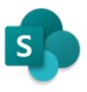
“By being able to visualize how well our students are reading, we’ve been able to make better choices for them. Putting (PowerApps & Power BI) in Teams made it easy for non-technical teachers to find and use those solutions. Even better, these tools help our educators to get creative, think outside the box and provide solutions for others—it‘s re-energizing!”
Lauren Taylor, Assistant Vice Principal | Tacoma Public Schools
Business outcomes
Top integrations leveraged
Information loss reduction
Paper-based processes were digitized, ensuring that valuable student data is recorded and analyzed
Greater insights
Admins use more data to track student reading scores, allowing fast and targeted interventions
Notes:
Link to story: “Assistant principal builds Power Platform solution to improve reading assessments”
Link to video: "Real World Stories: The rise of citizen development"
Capabilities/solutions leveraged: Microsoft Flow and PowerApps
Story summary:
Challenge: Lauren Taylor, Assistant Vice Principal with the Tacoma School District, wanted to find a better way to capture, record, and analyze individual student reading level assessments. At the time, an adult working with a child would generate a number score (based on how the session went) and hand write observations. But their system couldn't capture the notes, so often, vital information wasn’t passed on - and opportunities to fully understand where the student was - and how best to get them where they needed to be - were missed.
Solution: After exploring products in the Office 365 suite, she discovered Flow and began using it to automate simple tasks. From there she started experimenting with PowerApps and found the answer she was looking for. Describing herself as "not at all a developer," she easily created an app that not only recorded all the notes (on reading level assessments, mentioned above), but also visualized the data, allowing everyone to dig deeper into the insights and make better decisions for improving student scores.
Outcome: In no time, teachers have embraced the new system, and since it is embedded as a tab within Teams, it’s easily accessible and there's no need to leave an experience they are already familiar with. After enjoying such success with her first app, she's gone on to create more and hopes to encourage other schools to use Teams and PowerApps to create better outcomes for students across the district.

Slide 18

Next steps
Get started
Start using Microsoft Teams today
Pick one project or process
Do all collaboration on that project in Teams
Download the mobile app
Get support
Get deployment and adoption support from
FastTrack
Adoption Hub

Slide 19
Thank you.

Slide 20
Appendix

Slide 21
Why Microsoft Teams?
1
Teams is for every worker, from CEO to Firstline
2
AI-powered experiences delivered by the Microsoft Graph
3
Intelligent meeting solution with video, content share and notes
4
Range of certified devices for every size, space and working style
5
Deep integration with business processes and line of business apps
6
42 compliance regulations supported for customers
7
Available in 53 languages, 181 markets with data stored in region
Notes:
With the abundance of applications and choice in the market place, you may be asking yourself why Microsoft and Microsoft Teams is the best choice for you.
First, we have major investments and teams concentrated on building Teams for every type of worker, from CEOs to those on the first line.
Teams leverages the power of the Microsoft Group, the largest graph of human activity at work ever created, to deliver AI-powered experiences that actually make your life better.
Teams takes meetings to the next level – our Intelligent meeting solution provides everything that you need before during and after your meetings,
as well as a range of certified devices that support every type of meeting space that you might require.
We have deep integration with business workflows and line of business apps so you are able to efficiently optimize the tools and processes that are critical to your business.
We support more compliance regulations than any other vendor.
Only Teams is built on the strength and scale of Office 365 and is available in 181 markets and 53 different languages.
We are truly built to support worldwide enterprises, but with user friendly and intuitive tools that work for everyone.

Slide 22
Teams platform is built for flexibility
Tabs – a big canvas to host your UI
When your app needs a large area to present information to users a tab is a great place to show a list of work items or a dashboard users can chat about the content of your tab which will keep it foremost in a channel as a threaded conversation.
Message Actions – interpret a chat
The starting place is a conversation. Let users send text to your app and you can use it to create new things, add to existing entities
Bots – smart chat skills for your users
Use a bot to drive engagement in a channel or in 1:1 conversations. Bots are an excellent way to handle question and answer scenarios or times when you need to message a channel on behalf of your service. Our bots also let you host tabs for complimentary browsing scenarios and post rich interactive cards.
Task Modules – a dialog for tasks
Task modules let you open a dialog from bot cards or tabs. When you need to do a little form entry, a lookup, or keep a 1:1 interaction out of a channel, pop open a dialog.
Message Extensions – share rich cards
Your users can share rich actionable cards that grab people’s attention and can get simple jobs done without leaving the conversation. Why send a link when you can include summary, status, and a wide range of interactions.
Notifications – getting users’ attention
Use toast, @mentions, just posting to a channel to call attention to changes and important actions users care about. Teams gives your app the flexibility to proactively notify people as quietly or loudly as you need

Slide 23

AI in Teams
Transforming collaboration and communication
Insightful
Proactive
Adaptive
Notes:
How are we evolving Microsoft Teams to make it an even more powerful hub for teamwork?
One key investment area for us is AI.
By harnessing the power of AI, we have an opportunity to amplify human capabilities and grow human ingenuity. It is not about humans vs. Machine but for us it‘s about humans + machines vs. the problem.
By harnessing the power of AI in Teams, we have an opportunity to really transform how people collaborate and communicate – making their experience more insightful, proactive and adaptive.
Envision what AI in Teams could do for you and your users.
What if Teams could leverage AI to provide you with insights directly in the context of a chat or a channel right when you need it?
What if those
insights were proactive so that you don’t need to search for the information. Imagine [enter name of coworker] had asked me to share this deck with them today? Wouldn’t it be great if Teams could analyze the conversation and enable me to share the link with one click without me having to search for it?
What if all of these capabilities were adaptive, based on which device you use and based on your activity history, so that you have a truly personal experience?

Slide 24
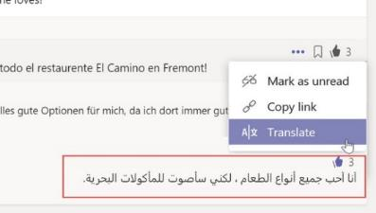
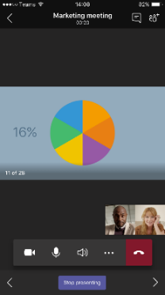

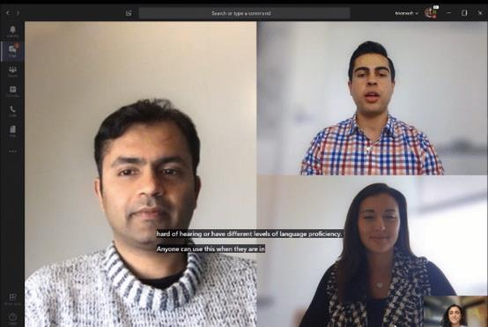
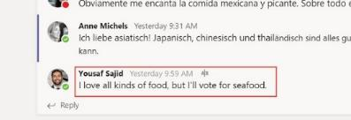
AI in Teams – available today
Inline message
translation
Mobile
companion mode
Meeting recording
transcription
Background blur and
live captions
Notes:
While some of this is still in the works, we already have AI powered capabilities in Teams today.
Inline message translation allows you to translate messages in channels and chat - into almost 40 languages. With a simple click, people who speak different languages can fluidly communicate with one another ensuring that every worker in the team has a voice and facilitate global collaboration.
Meeting recording and transcription powered by Stream enables all team members to easily catch up on missed meetings as you can read the transcription, search within the conversation, and playback all or part of the meeting.
With the mobile companion mode, Teams picks up if you are in a meeting room or suggests that you can use your phone as a companion device, so you can for example advance slides from your phone.
With background blur, participants can blur their background during a video call to ensure professional meetings on-the-go or avoid possible disturbances in the background like a dog running into the room. This allows other meeting attendees to focus on you, not what’s behind you.
Live captions

Slide 25

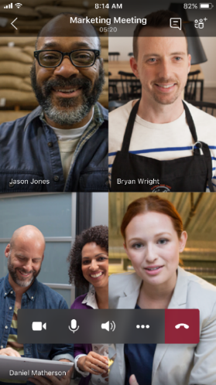
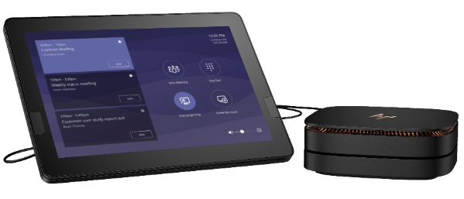
Meetings made simple
Consistent experiences everywhere
On the go, at your desk, or in a conference room, bring together both internal and external audiences of all sizes via scheduled and ad-hoc meetings and calling
Intelligent and inclusive
Share content across devices and keep people in the loop throughout the meeting lifecycle, including those who may have missed the meeting
Easy and secure to join and use
Stay confident knowing that Office 365 is powering your meetings with enterprise-grade AV experiences, security, and compliance

Slide 26

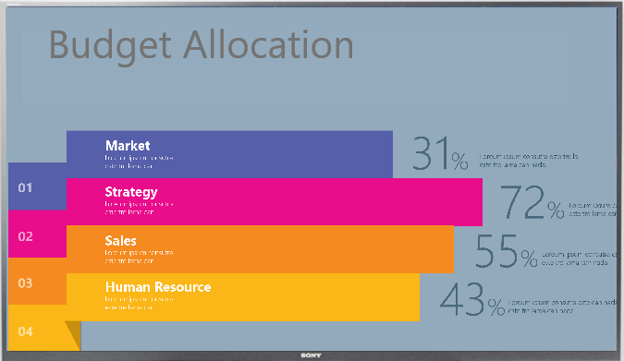

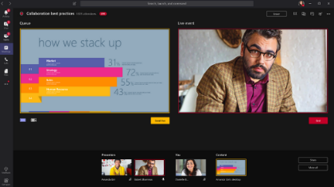
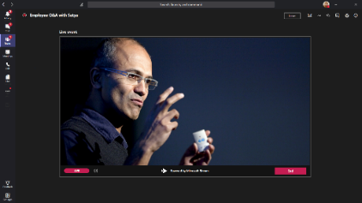
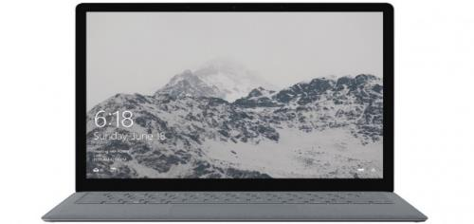
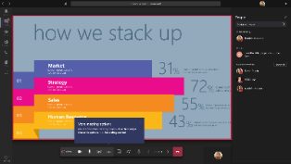





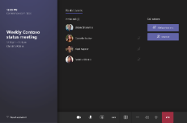
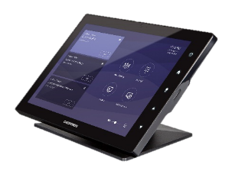
Meetings made simple
Easily schedule, start and join meetings or make calls from PC, Mac, mobile, web, or conference rooms
Our best-in-class applications provide a familiar Teams experience across all devices
Seamlessly join plug-in free Teams meetings and make calls via Chrome and Edge browsers
Schedule, produce and present Live Event meetings and broadcast to 10,000 attendees
Microsoft Teams Room systems provide one-touch meeting join capabilities to conference rooms
Budget Allocation
Budget Allocation
Budget Allocation

Slide 27

Intelligent and inclusive
Share desktop and applications with ease, including content from mobile devices
Meetings lifecycle keeps everyone in the know before, during, and after a meeting
Get more out of your meetings with automatic live captions and searchable transcripts
Cloud recording and playback with Stream means you won't miss the meeting, even if you missed the meeting
Bring everybody together with the integrated Microsoft Whiteboard and contribute in real-time with digital ink
Use background blur and custom backgrounds to remove distractions and personalize your video, calling and meeting experiences

Slide 28

Easy and secure to join and use
Office 365 compliance, security, and manageability means you can call and meet with confidence
Great audio, video and sharing quality over Wi-Fi and cellular networks
Adaptive A/V experiences over variable bandwidth networks provides optimized calling and meetings
Speak-while-muted and echo suppression alerts help you keep your meetings on track
No internet? No problem. Dial into meetings with Audio Conferencing, available in 90+ countries

