Slide 1

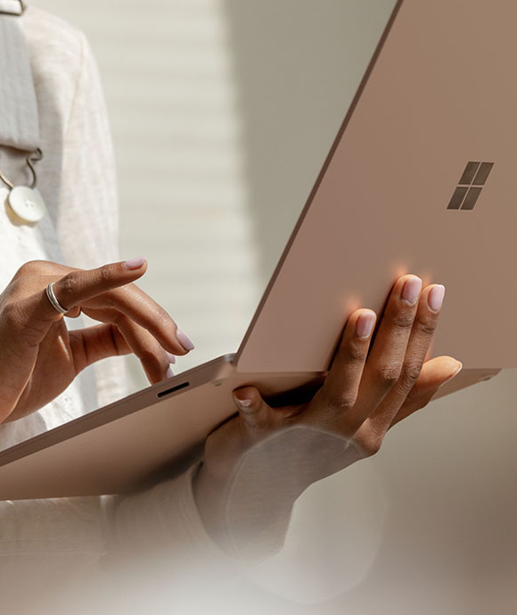
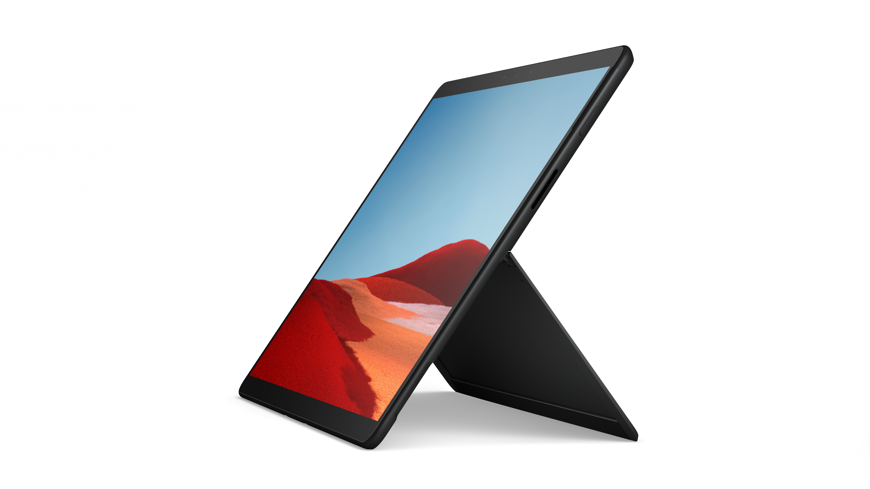

Access the latest Microsoft technology with Surface Device-as-a-Service​
Get the Microsoft hardware, software, and services you need in one monthly subscription.
Out with the old, in with the new
Benefits
Traditional hardware procurement:
Large capital investments are required upfront Overdue upgrade cycles impact productivity and security Large internal IT costs and processes
Device-as-a-Service:
Bundle premium Microsoft Surface devices with latest Microsoft software, accessories, and services into one monthly subscription Predictable spend spread across future months. Flexible subscription and financing options
Single point of contact for all hardware, software, and
support services
Reduced upfront costs with improved cash flow.
Stay current with easy upgrades to the latest Microsoft devices
Your custom solution in one monthly payment
+
+
+
Devices
Surface Pro Surface Book Surface Studio Surface Hub Surface Laptop
Software
Microsoft 365
Dynamics 365
Azure Cloud Services
Industry-specific
software
Accessories
Pens Keyboards Mice Headsets And more
Services + support
Imaging
Asset tagging Warranty
On-site support And more
To learn more about how
your business can benefit from Surface DaaS, reach out to your Microsoft Partner.

