Slide 1
Partner Marketing Center
Go-To-Market with Microsoft
Champion your marketing efforts and innovate with content

Slide 2
Introduction
Partner Marketing Center provides access to thousands of sales and marketing assets in a comprehensive content library, including sales presentations, infographics, web images, and more!
Access this full library of assets to quickly and easily go to market with Microsoft.

Slide 3
Partner Marketing Center campaign optimization
Marketing teams are taxed with so many responsibilities that searching for quality content either falls by the wayside or is too time consuming to do properly.
This is precisely why we built Partner Marketing Center. This digital content library is designed to accelerate your time to market, generate leads, and grow your cloud businesses. It includes customer pitch decks, Play-in-a-Box (PiB), playbooks, copy blocks to use on your websites or social media, customizable pre-written emails, solution training videos, and more. Partner Marketing Center helps you lay a solid marketing foundation, educate potential buyers and customers, and keep them engaged throughout their customer journey.
Differentiate your business through customizable marketing material and templates.
Save time and money through our ready-to-use content and services.
Increase customer leads, close more deals, and accelerate business to the next level with access to the right marketing tools.
“Honestly, I think the most valuable information (based on my role) is that seeing what Microsoft is focused on gives some insight into what they want us as a partner to focus on and where Microsoft is headed.”
-Microsoft partner

Slide 4
Partner Marketing Center benefits and outcomes
Readily available at your fingertips is customizable, in-depth marketing, sales and content with compelling and carefully curated positioning and messaging.
With Partner Marketing Center, it’s easy to save money by not having to search, find, and piece together content from multiple sources. It's also meant to work together with your Digital Marketing Content OnDemand episodic content; for example, should you choose to substitute one piece of content delivered to you by Digital Marketing Content OnDemand, you can easily do so. Partner Marketing Center is designed to amplify the One Microsoft message and create a consistent brand experience across our ecosystem.
Check out these actual partner metrics:
60K
Approximate number of unique partners reached through self-serve marketing annually.
1 Million
Content downloads in Fiscal Year 2019!
74%
Say it helps save in their marketing budget.
75%
Say Microsoft marketing support helps to increase revenue, save time and budget.
70%
Say it saves time to market.

Slide 5
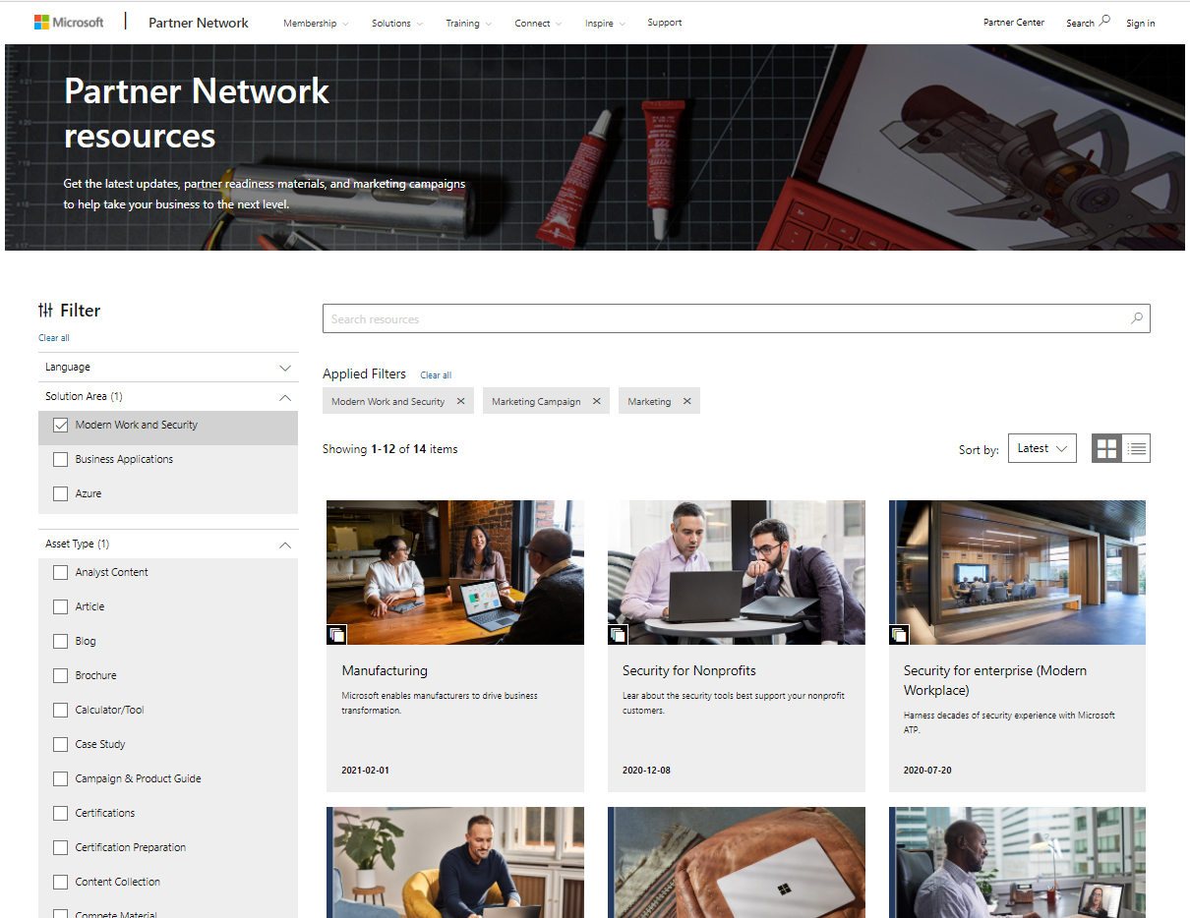
How to use Partner Marketing Center
Are you committed to giving your content a fighting chance?
Publishing information just to get something out the door is not a content strategy. Lackluster assets stemming from a poor strategy hurts your brand more than it helps. This is where Partner Marketing Center comes in. Think of it as your central repository and
self-serve content library. It offers a variety of qualified and vetted thought leadership and enablement material in many different formats—including customer pitch decks, copy blocks, pre-written emails, and more.
It’s easy to customize too! With custom fields and placeholders for your company branding, once you find a campaign that’s moving the needle, you can easily bookmark it for future use.
1
From the filters on the left, choose a solution area
2
From the filters on the left, choose an asset type (marketing campaign will automatically be selected for you)
3
At the top, search for key words using the search resources bar

Slide 6
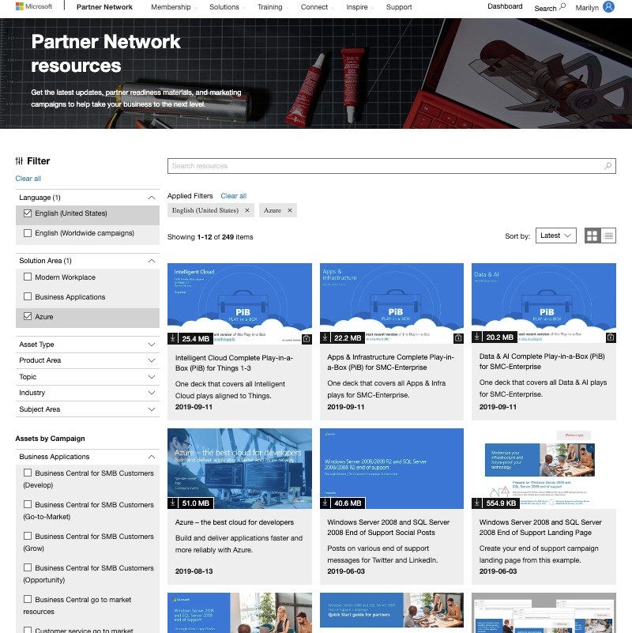
Identifying the right content
Sort assets by most recent, featured, and relevance using the “Sort by” drop-down in the upper right.
Asset search filters, including language, solution area, asset type, product type, topic, industry, and subject area are located on the left.
The asset library is displayed on the middle to right hand side of your screen.

Slide 7
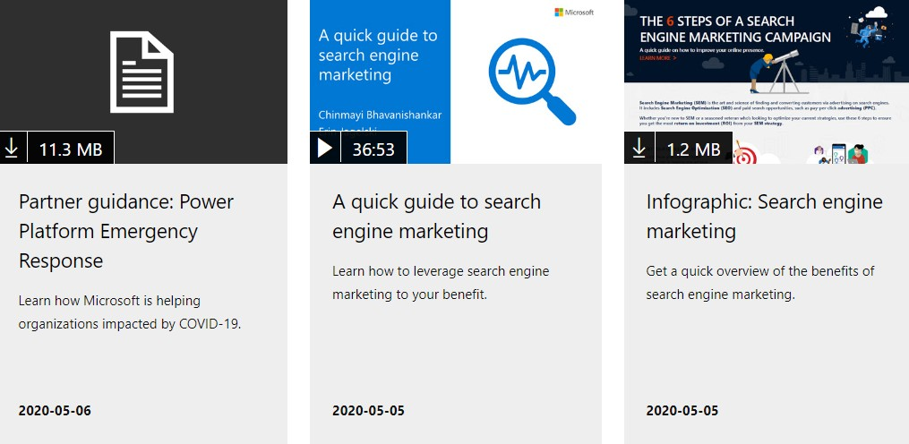
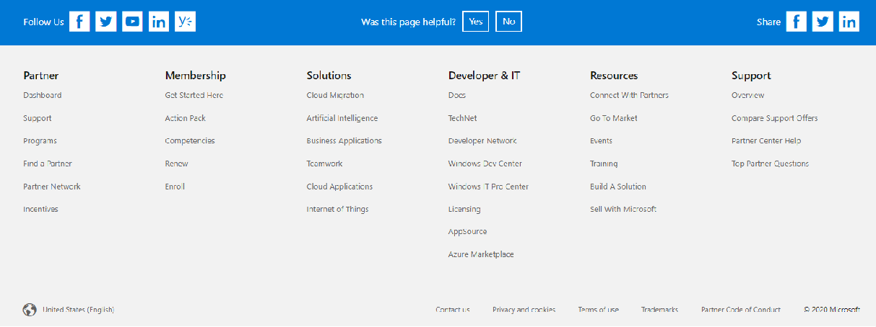
OPTMIZE
Localized content for marketing globally
Be sure to take advantage of the language filters (English – United States, English – worldwide campaigns and German) as Microsoft content is available around the globe and some countries localize and create their own campaigns. Use a combination of the search box at the top of your screen and the filters on the left to narrow down your selection.
Language selection in the filters only allows you to narrow your search from the available content in your current site.
To change to the localized sites, make the selection at the bottom left of the page:

Slide 8
Get started
Get started on finding powerful resources for a successful go-to-market plan here.
Additional resources:
Top partner questions library
Feedback and questions

