Slide 1
Build Agile Business Processes
Modernize, automate, and innovate faster

Slide 2
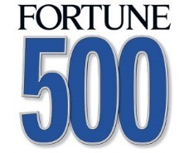
The only thing harder than transformation is… failing to transform
Opportunity
Threat
$100 trillion opportunity
for society and industry over next 10 years
52% of companies in the Fortune 500 since 2000 are gone.
….the majority of companies will not exist in a meaningful way 10 to 15 years from now.
- World Economic Forum
Notes:
Talking points
Organizations that fail to transform face the threat of becoming irrelevant.
Industry data shows that the rate of failure is significantly higher when companies don’t embrace change.
Slide objective
Show why digital transformation is so important.
Speaker notes
Organizations that fail to transform face the threat of being irrelevant. They risk losing out to disruptive changes in their industry.
The combined value – to society and industry – of digital transformation across industries could be greater than $100 trillion over the next 10 years.
The effects of digital technologies as a whole, including mobile, cloud, artificial intelligence, sensors, and analytics, are accelerating progress exponentially.

Slide 3
Build agile business processes
Adapt business processes now to be ready to adapt changing technologies and demand as they happen
Modernize
Build a productive remote workforce
Build a resilient supply chain
Microsoft Teams
Power Apps
Power Automate
Power Virtual Agents

Slide 4
Modernize
Optimize IT performance and reduce backlogs to respond more quickly, accurately, and completely
Replace or upgrade legacy apps and platforms for greater resilience and business agility
Unify data across a single platform as it makes sense for your business
Reduce time and costs by optimizing everyday tasks with intelligent automation – and better differentiate and compete
Notes:
Conversation
Use Cases (Product Truth)
Modernize Business Applications with Azure
(Modernize .Net Apps & Cloud Native Apps)
Reduce technical debt and your IT backlog
Replace or upgrade legacy apps and platforms
De-risk legacy and custom apps that are non-compliant
Create single platform, systems-of-record experience with CDS and Power Platform using premium connectors
Integrate LOB solutions into an existing technology stack by embedding new experiences and minimizing steps
No-cliffs developer automation with Power Automate
SAP on Azure
Upgrade data and/or application estate
Replace legacy apps and platforms with a better user focused experience
Connect systems for seamless data integration
Scale apps pre & post migration

Slide 5
Build a productive remote workforce
Empower your team to effectively collaborate from anywhere
Connect everyone within your organization to collaborate with virtual events and communication delivering the best virtual desktop experience
Improve productivity by integrating apps and automating workflows
Rapidly develop and make productivity applications available on any device to reduce time and cost spent on rote tasks so that you can be more productive and happier
Ensure security across applications and devices
Provide enterprise grade security and compliance with secure remote access to applications and secure managed and unmanaged devices
Notes:
Insert Teams lingo here
Enable Secure Remote Work (Teams Meeting & Calling, Security)
Enable people to meet and collaborate at home, and keep them engaged
Rapidly develop and make productivity applications available on any device
Engage people with virtual events and communications
Deliver the best virtual desktop experience
Secure remote access to applications
Secure managed and unmanaged devices
Transform Organizational Productivity
(Teams Platform, Firstline Workers)
Build a happier and more productive organization
Streamline business processes: Improve productivity by integrating apps and automating workflows across Office 365, with Microsoft Teams, the hub for teamwork
Automate routine tasks: Reduce time and cost spent on rote tasks and automate routine business processes between your favorite apps like Excel, Outlook and SharePoint so that you can be more productive and happier

Slide 6
Build a resilient supply chain
Maximize operations with intelligent tools and apps that improve manual and business processes
Enhance end to end visibility of your supply chain and predict both upstream and downstream impacts due to supply chain interruptions
Construct agile planning and distribution processes
Optimize everyday tasks with intelligent automation for workflows between your favorite apps and services to synchronize files, get notifications, collect data and more
Notes:
Build a Resilient Supply Chain
Workforce optimization: Enhance operations with intelligent tools and applications that improve and replace manual business processes (D365 Commerce, SCM, PowerApps, AI & IOT, Guides, Remote Assist) (Business Central)
Enhance Supply Chain visibility: Improve end to end visibility of your supply chain and predict both upstream impact (suppliers) and downstream impact (customers) due to supply chain disruptions (D365 SCM, Commerce w/integrated out of the box Power BI dashboards) (Business Central)
Accelerate everyday business process with Dynamics 365
Optimize everyday tasks with intelligent automation: From dispatching field service technicians to invoice processing you can automate processes across the entire suite of Dynamics 365 solutions with Power Platform (Automate)3

Slide 7
Benefits of low-code app development
Low-code platforms enable a visual approach to building apps, empowering everyone, regardless of whether they can code or not, to quickly turn their bright ideas, into brilliant apps
For speed
For efficiency
For adapting quickly
Leverage the Common Data Service with pre-built AI models in AI Builder, and unlock value faster across your organization
Build custom apps in hours – not months – that connect to your existing data and systems to solve problems faster and drive efficiency
Reduce time & cost building web and mobile applications, enabling you to get through your development backlog
Power Platform

Slide 8
Start your transformation journey today
Connect with us to learn more
Notes:
Note – include Secure Infra and/or Data & AI SSSPs as appropriate depending on the area of customer interest.

Slide 9
Appendix

Slide 10
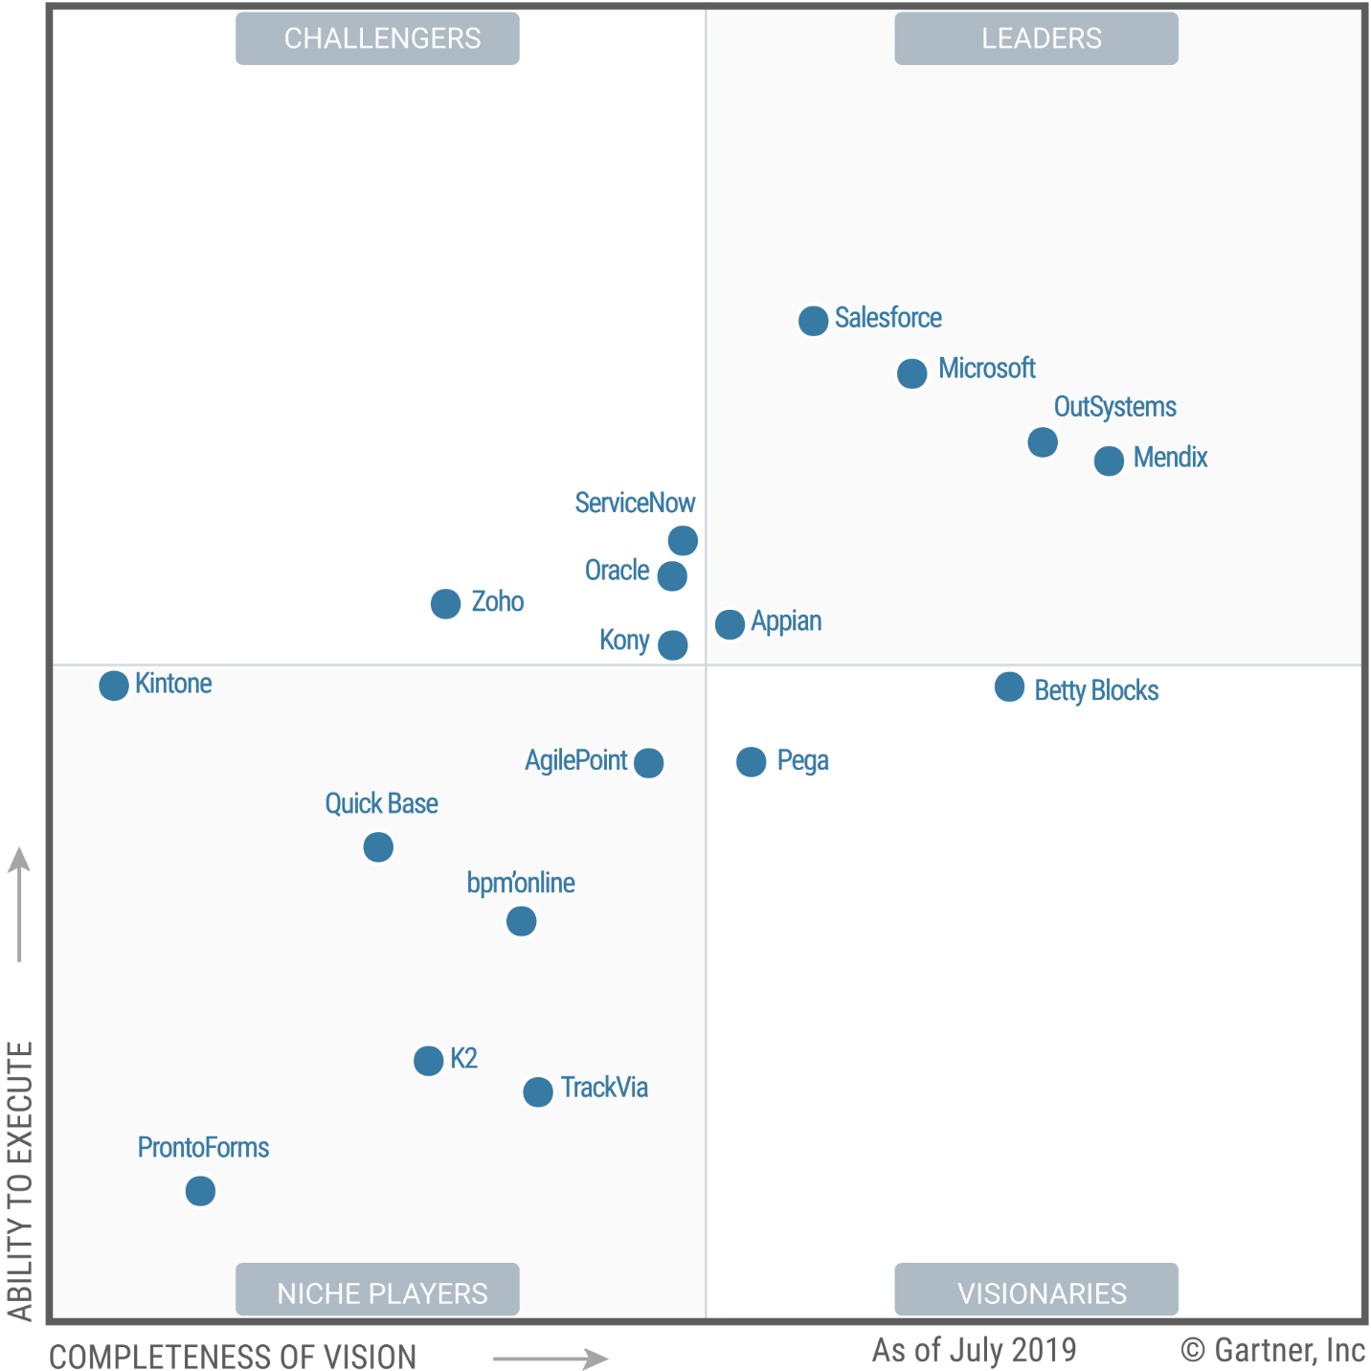
August 2019
A Leader in Enterprise Low-Code Application Platforms*
*Gartner “Magic Quadrant for Enterprise Low-Code Application Platforms,” by Paul Vincent, Kimihiko Iijima, Mark Driver, Jason Wong, Yefim Natis, 08 August 2019
The above graphics were published by Gartner, Inc. as part of a larger research document and should be evaluated in the context of the entire document. The Gartner document is available upon request from Microsoft. Gartner does not endorse any vendor, product or service depicted in its research publications, and does not advise technology users to select only those vendors with the highest ratings or other designation. Gartner research publications consist of the opinions of Gartner's research organization and should not be construed as statements of fact. Gartner disclaims all warranties, expressed or implied, with respect to this research, including any warranties of merchantability or fitness for a particular purpose. GARTNER is a registered trademark and service mark of Gartner, Inc. and/or its affiliates in the U.S. and internationally and is used herein with permission. All rights reserved.

Slide 11
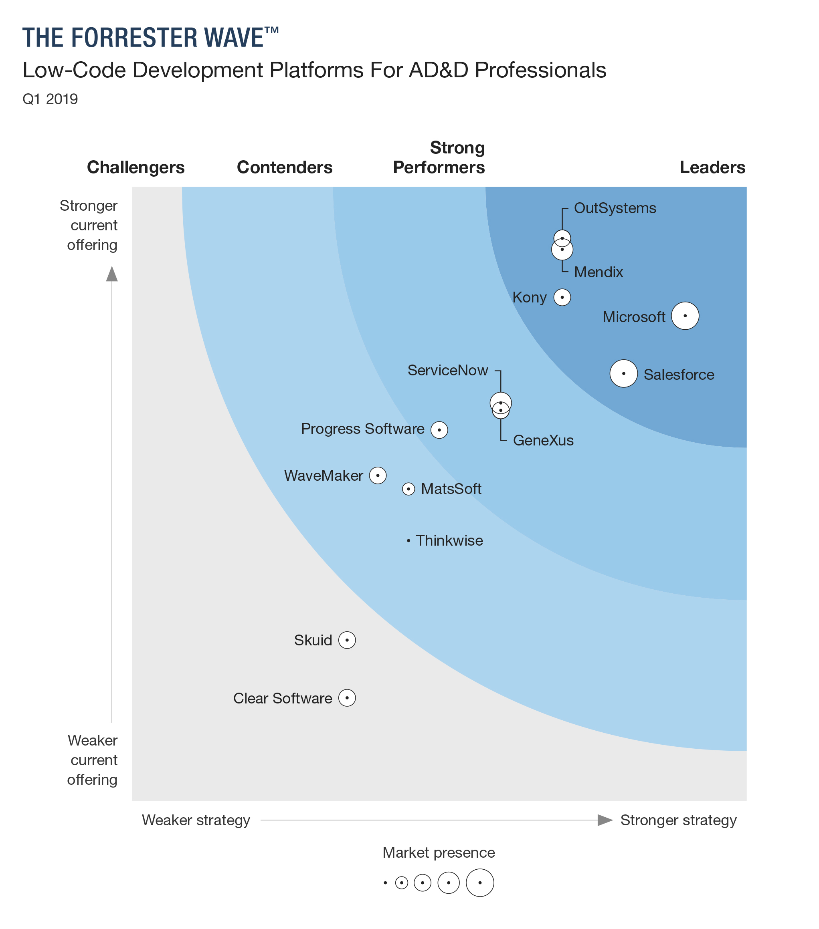
Forrester names Microsoft a leader in low-code development platforms
We are thrilled to announce that Forrester has recognized Microsoft as a leader in low-code development platforms in the 2019 Forrester Wave for Low-Code Development Platforms for Application Development and Delivery (AD&D) Professionals
https://aka.ms/forresterLCAPwave2019

Slide 12
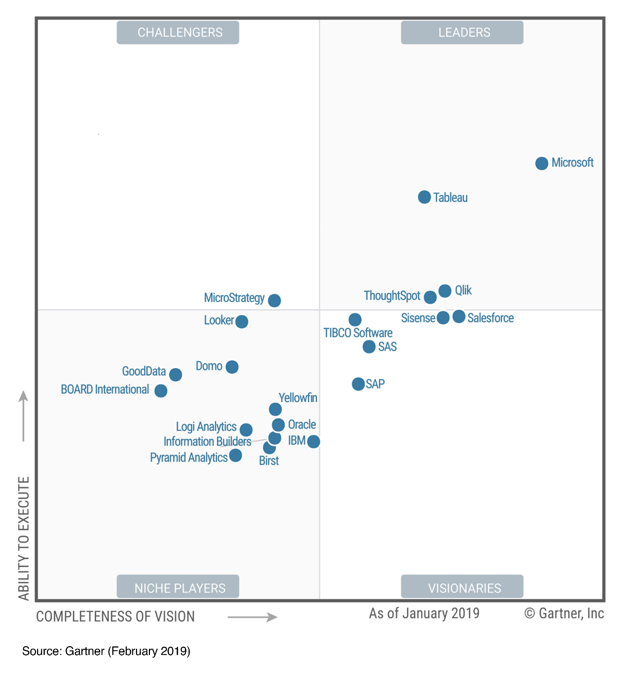
February 2019
A Leader in Analytics & BI Platforms*
*Gartner “Magic Quadrant for Analytics and Business Intelligence Platforms,” by Cindi Howson, James Richardson, Rita Sallam, Austin Kronz, 11 February 2019
The above graphics were published by Gartner, Inc. as part of a larger research document and should be evaluated in the context of the entire document. The Gartner document is available upon request from Microsoft. Gartner does not endorse any vendor, product or service depicted in its research publications, and does not advise technology users to select only those vendors with the highest ratings or other designation. Gartner research publications consist of the opinions of Gartner's research organization and should not be construed as statements of fact. Gartner disclaims all warranties, expressed or implied, with respect to this research, including any warranties of merchantability or fitness for a particular purpose. GARTNER is a registered trademark and service mark of Gartner, Inc. and/or its affiliates in the U.S. and internationally and is used herein with permission. All rights reserved.

Slide 13
Total Economic Impact (TEI) of PowerApps and Microsoft Flow
We used to have three full-time people writing reports. That’s now down to only one person
—CLIENT
In the first year we saved $500,000 in external developer costs. We expect to see similar savings in future years
—CLIENT
We reduced our time to quote from twelve days down to four
—CLIENT
70%
Less application development cost & effort
362%
Return on investment over 3-year term
<3 Months
Payback
Source: The Total Economic Impact™ Of PowerApps And Microsoft Flow, a commissioned study conducted by Forrester Consulting on behalf of Microsoft, June 2018

Slide 14
Customer stories

Slide 15
Customer stories
Learn more
Learn more
Learn more
Learn more
Learn more
Learn more
Learn more
Learn more
Notes:
https://powerapps.microsoft.com/en-us/customer-stories/

Slide 16
Transforming in-store merchandising and auditing to achieve targeted business goals
Notes:
The field teams at G&J Pepsi have always embraced technology on behalf of their customers. When the IT department was tasked with delivering more on-the-go services for the company, they embraced the opportunities and challenges. By using Microsoft PowerApps, Power BI, and Microsoft Flow, the seven-person team created custom applications to automate the company’s store audit and merchandising process. They were able to build, deploy, and manage this scalable end-to-end solution without previous app development experience.
Delivering a better experience
G&J Pepsi, headquartered in Cincinnati, Ohio, has more than 1,600 employees focused on manufacturing, distributing, and marketing the full line of Pepsi-Cola products. Most staff members spend their time in the field managing their retail accounts.
As the industry is becoming more reliant on mobile phones and tablets for business, Eric McKinney, Cloud Services Manager, and the G&J IT team, was tasked with delivering more on-the-go services for the company. With a goal of becoming more efficient, gaining new insights, and keeping the company better connected with its customers, he set out to create a better experience.
https://customers.microsoft.com/en-us/story/gj-pepsi-consumer-goods-powerapps

Slide 17
Heathrow prepares rather than reacts: Uses data to deliver airport calm
Notes:
Travel can be stressful, especially when flights are cancelled or plans change. Heathrow Airport is using Microsoft Power BI and Microsoft Azure to make travel less nerve-wracking for the airport’s 200,000 daily passengers. Heathrow uses Azure to pull data out of back-end business systems and push it to Power BI, which shows employees at a glance and in real time how airport passenger traffic is changing so they can prepare. By using data to understand its business better than ever before,
Heathrow is transforming the travel experience.
Heathrow Airport is the United Kingdom’s gateway to the world. Every day, 200,000 people pass through Heathrow en route to parts unknown. The airport’s ambition is to deliver “happy passengers, traveling with their bags, on time.” It delivers on that promise using Microsoft Power BI to bring real-time operational data to life for 75,000 airport workers, who are better able to keep passengers moving smoothly through the airport through stormy weather, cancelled flights, and other disruptions.
https://customers.microsoft.com/en-us/story/heathrow-airport-travel-transportation-powerbi-azure

Slide 18
Louisiana-Pacific stays at the cutting edge by transforming manual processes with Microsoft Flow
Notes:
Over the last 45 years, Louisiana-Pacific Corporation (LP) products have become a staple of professional and personal building projects. And LP is determined to stay at its industry’s cutting edge. From the company’s headquarters in Nashville, Tennessee, to its mills across the Americas, LP is using Microsoft Flow and PowerApps to empower its employees and streamline and automate traditional paper-based processes. The results? Lower costs, increased productivity, and more than USD1 million in net new pipeline opportunities.
Building simpler and smarter ways to work
In the fast-changing building products industry, Louisiana-Pacific Corporation (LP) is excited to be leading the way in new, innovative construction solutions—and in creative ways to do business. Traditionally, companies that manufacture building materials have depended on slower, manual, paper-based processes—both in their manufacturing operations and in their sales and marketing activities. But with a business-wide transformation initiative underway to modernize the company’s processes, Quentin Hilman, IT Manager at LP, was on the lookout for a way to streamline processes and improve overall equipment effectiveness (OEE).
Having helped mastermind the company’s adoption of Microsoft Office 365, Hilman began to explore the full extent of the suite, and he quickly saw how LP could use Microsoft Flow and Microsoft PowerApps to meet its goals. “When I discovered Microsoft Flow and PowerApps, I knew they were going to be very powerful,” he says. “We took those tools, and we ran with them.”
Microsoft Flow now acts as the middleware for a huge range of processes at LP, from approvals to data collection, integrating with Office 365, SharePoint Online, and even several third-party tools and add-ins.
https://customers.microsoft.com/en-us/story/724264-louisiana-pacific-flow-manufacturing

Slide 19
%
“We want to be an airline that people love to fly with. From their experience selecting and booking the flight through to their destination, we want them to already be thinking about their next trip with Virgin Atlantic.”
Nic Whittaker
Head of Platform Engineering and DevOps
Virgin Atlantic provides hassle-free, personal travel experience
Enhances customer service delivery with customer data profiles & custom apps
Improves customer experience with intuitive booking processes
Increases customer satisfaction with customized offers and service
Automates auditing processes and eliminates paper with PowerApps
Connects and integrates data to Dynamics with Flow
Notes:
A global airline that is well established with great customer service and a singular goal to have every traveler thinking about their next journey on their airline.
Virgin saw ROI in their existing implementation of D365 and got an idea to accelerate their digital transformation of their customer experiences with PowerApps
Let’s discuss the Spa check in app. Uses Dynamics 365 to serve up a customer record when people arrive for their spa treatments during stressful travel, Flow retrieves the data and serves up a PowerApps application that collects the health questionnaire information from the customer and serves back info about their flight status and upcoming treatments. This process eliminated many manual paper processes and compliance risks in not attaining correct information from customers.
This gave Virgin an idea, to use PowerApps and Flow to automate audit and maintenance processes all around the company, removing paper and creating better experiences for their employees and contributing to ROI through better information about aircraft maintenance and fuel expenditures
Great success story for both Citizen and Pro dev alike, using Azure services and devops in addition to Power Platform and D365
Highlighted in ScottGu’s keynote at Build in May, please watch that and learn more.

Slide 20
%
“The traditional approach in manufacturing involves collection of data on paper, whiteboards and legacy systems. As a business we’re asking, how do we use emerging toolkits to help us gain an edge.”
Amit Raniga: Director
Majans spices up operations with Dynamics 365; lays foundations for factory of the future
Replaced SAP Business One solution with Dynamics 365
Enabling last mile requirements for QA and production systems with PowerApps
Leveraging extensibility between Dynamics and Power Platform to enable LEAN
Leveraging Flow, Sharepoint, and PowerBI to visualize data generated from PowerApps
Notes:
Park Place Technologies is a U.S.-based provider of post-warranty IT services and maintenance to more than 15,000 customers worldwide. To keep up with their rapid growth in recent years, they’ve implemented leading-edge technology to help sales staff better understand existing customers and drive engagement with better qualified prospects.
They are enabling customers to engage with them digitally at every point of interaction, from looking at sales quotes and product options to calling for service dispatch and tracking issue resolution. Technology is helping them to build relationships between employees and customers, while providing the sales force with access to the right information at the right time to make meaningful connections and assist customers in every need.
By centralizing their customer data and gaining a singular view with insights driven by AI and machine learning, Park Place is able to better understand its customers, their needs, and determine those who are most likely to purchase their services. They can engage customers and prospects in more personal ways across all channels, interacting with them through the channels they prefer.
Since implementing a data-driven approach that enables engagement of better qualified prospects and to better serve its customers, Park Place Technologies has solidified an impressive customer satisfaction rate of 97 percent and a contract renewal rate of 99 percent.

Slide 21
%
“With business applications built on Microsoft PowerApps and Dynamics 365, we’ve lowered the barrier for bringing innovative solutions to our employees quickly.”
Vishwanath Anantraman: Chief Innovation Architect
New York’s largest healthcare provider streamlines patient care processes with Microsoft business
With Microsoft Dynamics 365 and Microsoft PowerApps, Northwell is giving employees powerful new tools to optimize patient care, reduce costs, and ensure regulatory compliance
Created a rounding app in a few weeks with PowerApps and CDS, leveraging the CDM Healthcare accelerator
Notes:
Park Place Technologies is a U.S.-based provider of post-warranty IT services and maintenance to more than 15,000 customers worldwide. To keep up with their rapid growth in recent years, they’ve implemented leading-edge technology to help sales staff better understand existing customers and drive engagement with better qualified prospects.
They are enabling customers to engage with them digitally at every point of interaction, from looking at sales quotes and product options to calling for service dispatch and tracking issue resolution. Technology is helping them to build relationships between employees and customers, while providing the sales force with access to the right information at the right time to make meaningful connections and assist customers in every need.
By centralizing their customer data and gaining a singular view with insights driven by AI and machine learning, Park Place is able to better understand its customers, their needs, and determine those who are most likely to purchase their services. They can engage customers and prospects in more personal ways across all channels, interacting with them through the channels they prefer.
Since implementing a data-driven approach that enables engagement of better qualified prospects and to better serve its customers, Park Place Technologies has solidified an impressive customer satisfaction rate of 97 percent and a contract renewal rate of 99 percent.

Slide 22
%
“Thanks to the vast IT resources of the cloud and an enterprise-class ERP solution like Dynamics 365 for Finance and Operations, we were able to implement high-volume mass production—cost-effectively, at scale, in only six months.”
Tim Gryder: Project Manager and System Administrator
Utility vehicle manufacturer uses cloud solutions to support exceptional annual growth
The company selected a full line of Microsoft software, including Dynamics 365 for Finance and Operations and Power BI, to build an end-to-end cloud-based IT infrastructure in only six months.
Intimidator also plans to use Microsoft PowerApps to speed and simplify application development and customization with minimal internal IT resources
Notes:
Park Place Technologies is a U.S.-based provider of post-warranty IT services and maintenance to more than 15,000 customers worldwide. To keep up with their rapid growth in recent years, they’ve implemented leading-edge technology to help sales staff better understand existing customers and drive engagement with better qualified prospects.
They are enabling customers to engage with them digitally at every point of interaction, from looking at sales quotes and product options to calling for service dispatch and tracking issue resolution. Technology is helping them to build relationships between employees and customers, while providing the sales force with access to the right information at the right time to make meaningful connections and assist customers in every need.
By centralizing their customer data and gaining a singular view with insights driven by AI and machine learning, Park Place is able to better understand its customers, their needs, and determine those who are most likely to purchase their services. They can engage customers and prospects in more personal ways across all channels, interacting with them through the channels they prefer.
Since implementing a data-driven approach that enables engagement of better qualified prospects and to better serve its customers, Park Place Technologies has solidified an impressive customer satisfaction rate of 97 percent and a contract renewal rate of 99 percent.

