Slide 1
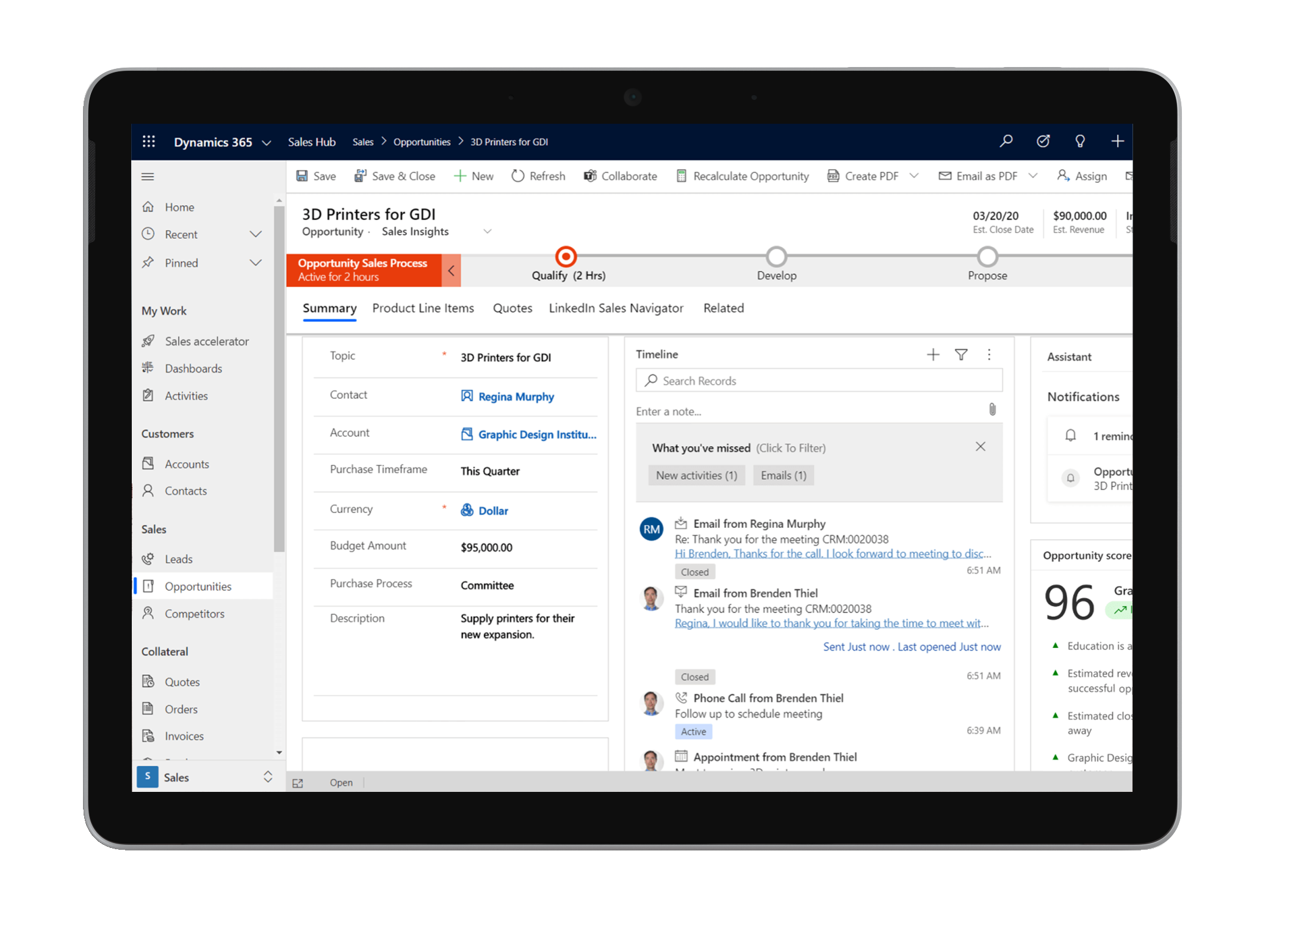
Buying is a journey empower your sellers to lead the way
Today’s buyers are changing the rules of the game. They want experiences and that includes frictionless transactions. That isn’t enough. Go beyond transactions and interactions to give your buyers unique experiences that build trust. Transform the sales experience with Dynamics 365 Sales.
Enable smarter selling with contextual AI
Boost sales productivity with seamless tools
Increase sales profitably with advanced insights
Empower sellers to build relationships
Improve coaching and sales performance
Innovate with sales solutions built to evolve
Customers are transforming with Dynamics 365 Sales
“Working with Microsoft ensures our field teams stand out, giving us the data and digital tools to have better relationships with our customers.”
Darrell Brown,
Executive Vice President, Ecolab

