Slide 1
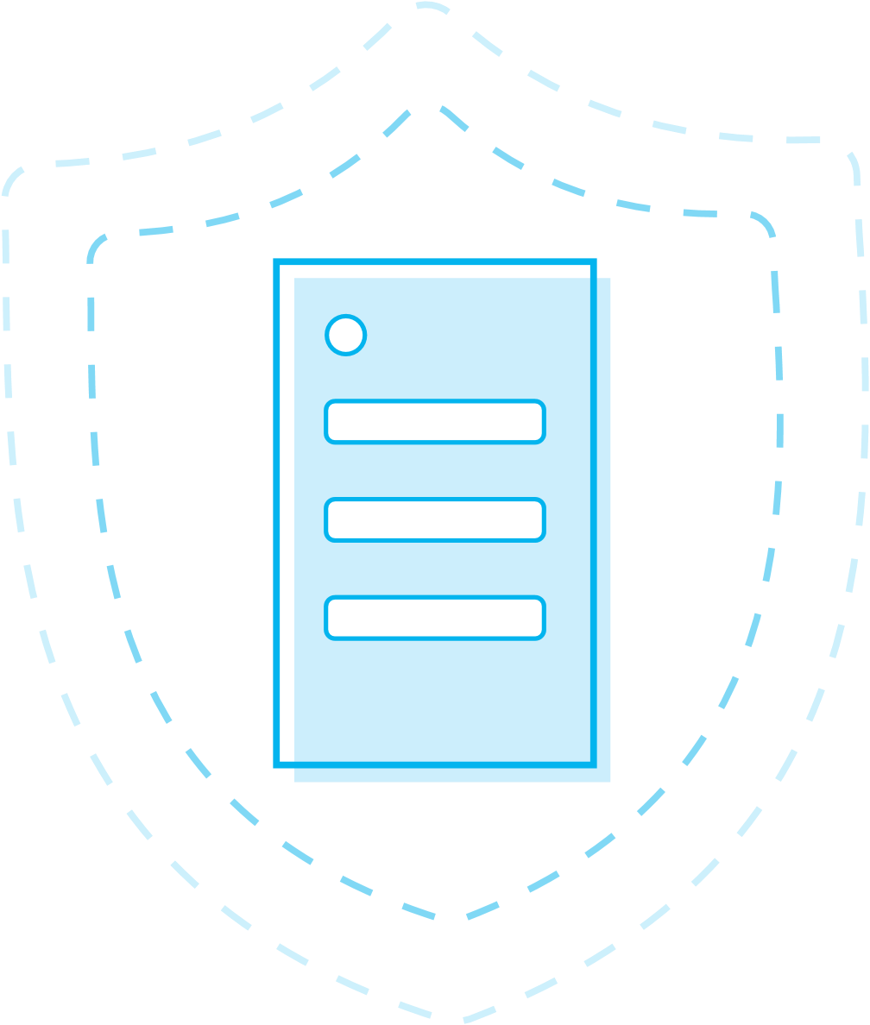
Securing software, together
We all play a role in securing the world’s code—developers, maintainers, researchers, and security teams. On GitHub, teams work together to secure the world’s software at every step.
GitHub’s approach to security
Protecting codebases
Automated updates
Security
alerts
Secret
scanning
Automated security updates keep projects secure and up to date by monitoring them for vulnerable components
Works with security researchers, maintainers, and developers to prevent new vulnerabilities from entering software projects
Tracks vulnerabilities in packages from supported package managers using data from security researchers, maintainers, and the National Vulnerability Database
Watches public and private repositories for known secret formats and immediately notifies either the secret provider or private repository admins when secrets are found

