Slide 1
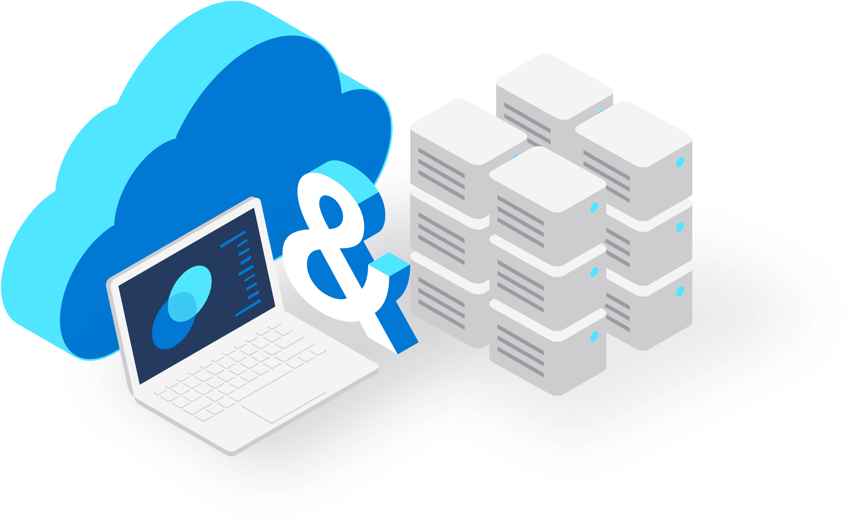
Get started with GitHub and Azure DevOps
Adopting the tools and mindset of DevOps in the right manner will facilitate development efficiency, increase productivity, and increase the rate at which products can be brought to market.
Here are four helpful tips for getting started
1
2
3
4
Start with small projects and teams:
Starting with small DevOps projects and teams allows you to work out any kinks within the organization or processes before scaling up.
Choose the right projects and the right teams: New projects and small development cycles offer great opportunities to start using a DevOps approach.
Choose the right tools for collaboration: Using a complete Application Life Cycle Management tool (Azure DevOps) centralizes development of backlogs, stories creation, code repositories, and more that can help reduce overhead and improve efficiency.
Customer and process streamline focus: Customers demand continuously improved products. A well-streamlined DevOps organization can stay ahead of the competition by rapidly delivering new features and products.

